Slide 1
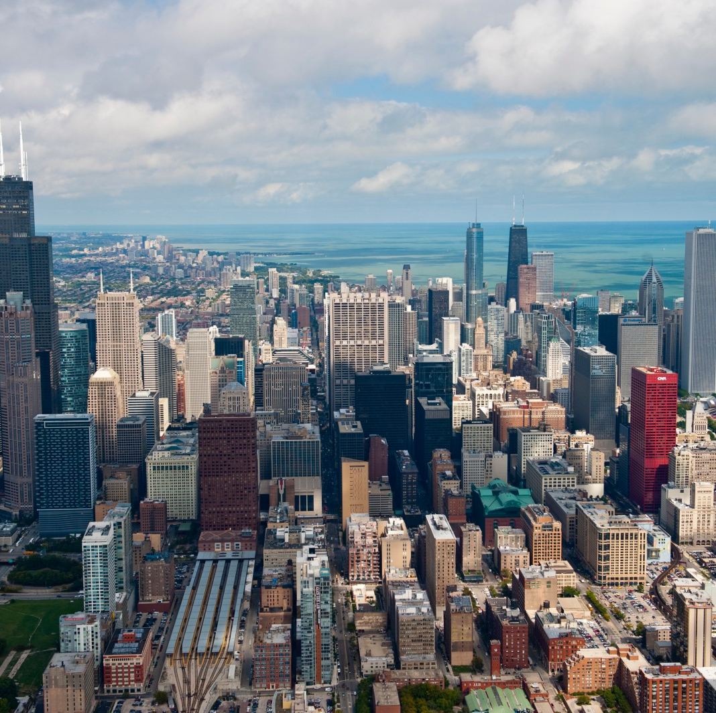
Quality of life in towns
Wider range of services
More job opportunities
Better Infrastructure
Noisier
Higher cost of living

Slide 2
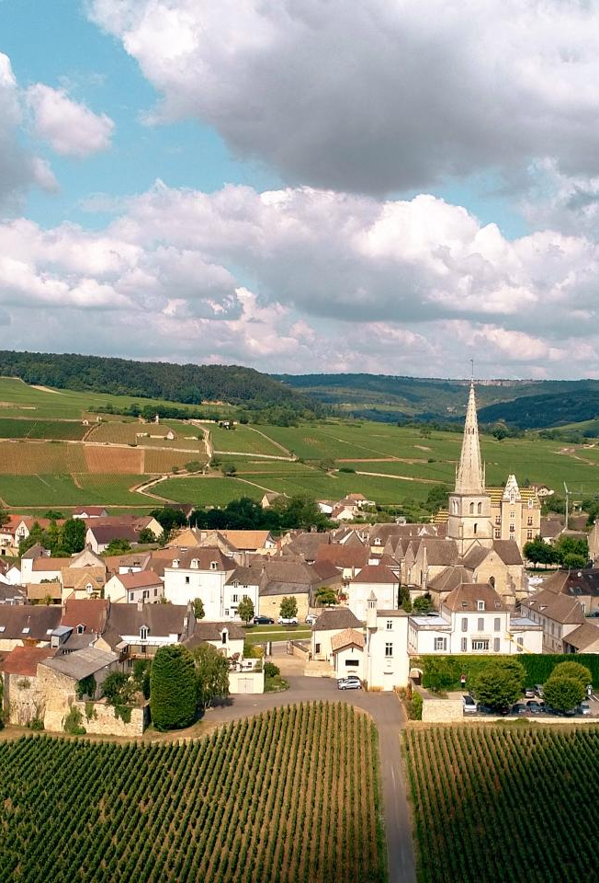
Quality of life in villages
Communities
Peaceful and quiet
Closer to nature
Lower cost of living

Slide 3
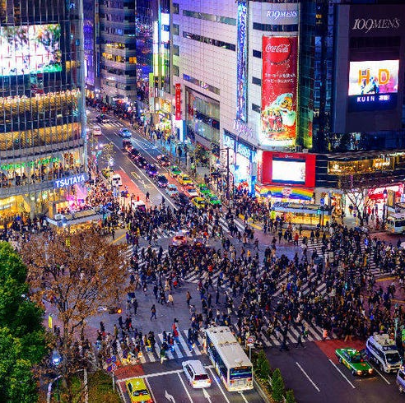
Means of transport in towns
Private cars, bicycles
Taxis
Public transport: bus, coach, trolley, subway, tram

Slide 4
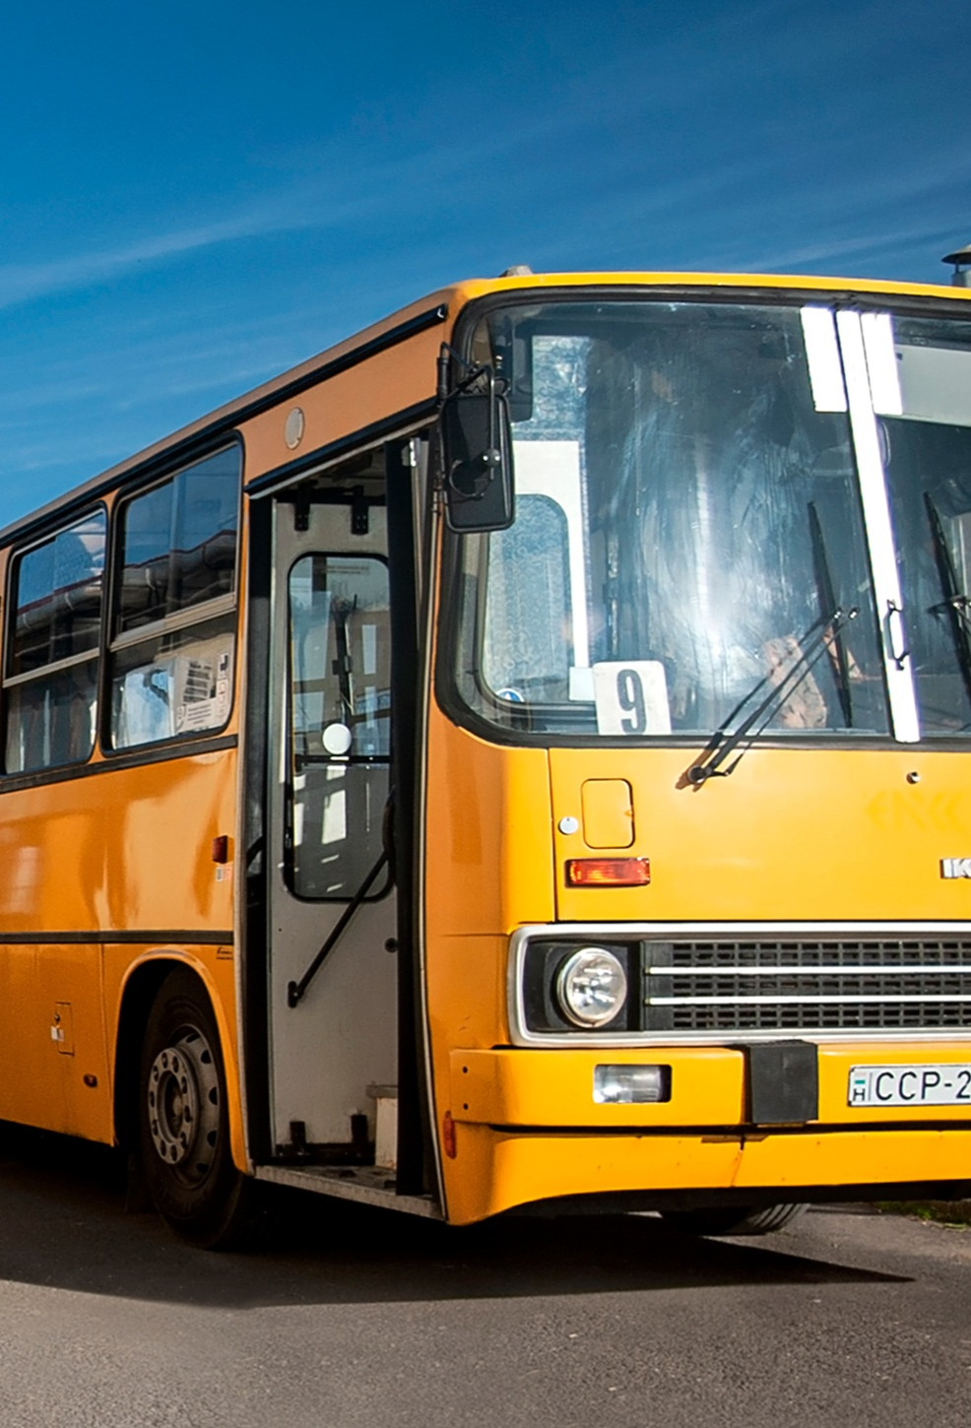
Means of transport in villages
Private cars, bicycles
Walking
Limited public transportation: bus, coach

Slide 5
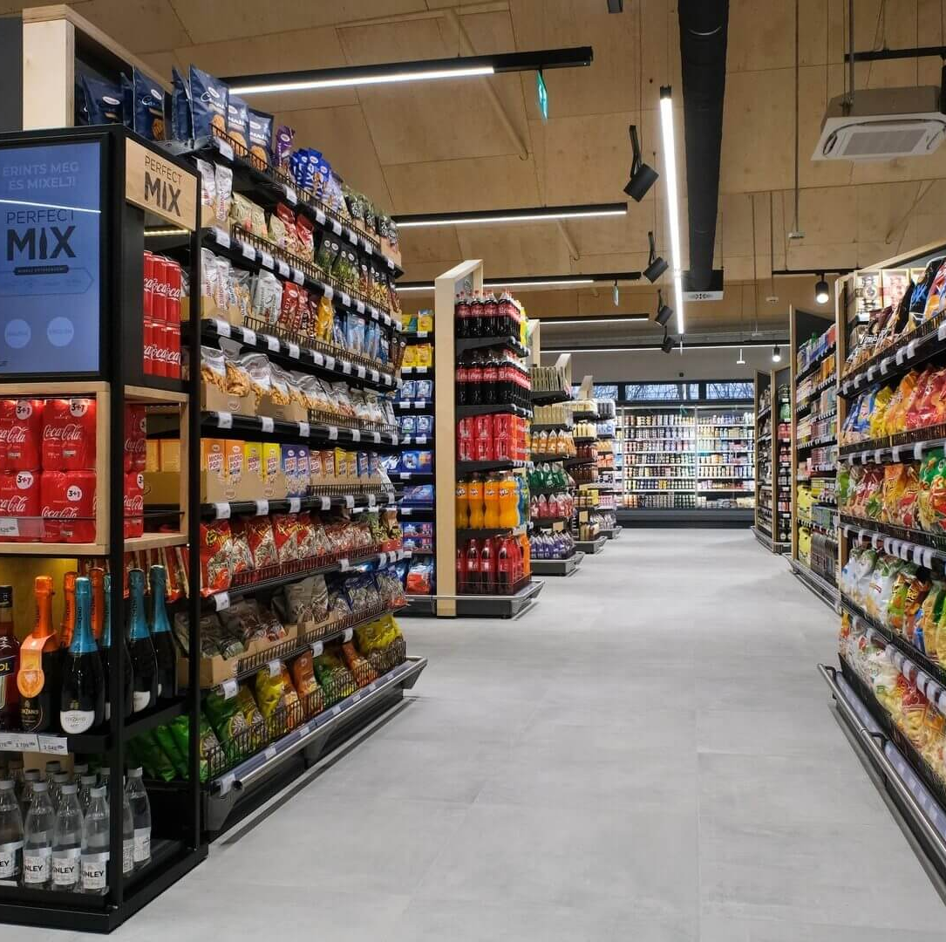
Services in towns
Professional Services: Healthcare Facilities, Banking Services
Educational Institutions: Universities
Supermarkets
Entertainment: cinemas, restaurants, nightlife

Slide 6
Services in villages
Basic Healthcare
Primary and Secondary schools
Local shops
Local gatherings, outdoor activities, traditional performances

